Slide 1

Tourium: Sprint 3
John Arnett, Laney Brager, Brandon Hightower, Dallon Phipps
Notes:
John

Slide 2

Overview
Guided tours
Benefits: education
Difficulties: accessibility by offline mobile devices, ease of creation, cost.
Aim: give the audience the ability to create location-based guided tours around publicly accessible properties.
Intended Audience: public land managers, public service volunteers, community members, and visitors.
Notes:
Dallon

Slide 3
Sprint Goal
Make and Take tours
Edit tours
Make locations
Integrate difference between official and unofficial tours
Notes:
John

Slide 4

Major Sprint Achievements
Improved UI
Taking and Editing Tour Points
Making and Editing Locations
Favoriting Tours
Explore Mode for Locations
Moderator Application
Notes:
John

Slide 5
Project Backlog and Sprint Backlog
Abort Tour while in Progress
In Medias Reas Tour Commencement
Visitor Upload Images
Visitor Comments
Moderate Comments/Images
Report Trail Issue
Report App Issue
Brief tutorial at beginning of app
Scavenger Hunt
Download Offline Map
Hashtag Integration
Verify Manager
Record Route in Person
Able to manage a tour from a website interface
QR Code to Access Trails
Manager Use Statistics Reports
Notes:
Laney

Slide 6
Lessons Learned
Getting a device’s location is difficult
Updating views to Recycler Views
Not Completed
Implementing tour features (comments, audio)
Offline mode
Management Website
Notes:
Laney

Slide 7
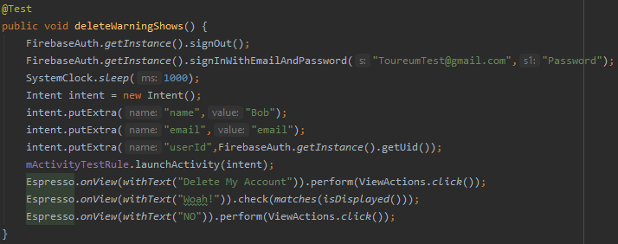
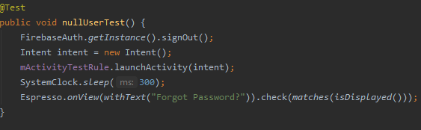
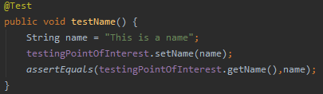
Test Cases
Notes:
Dallon

